Slide 1
Final Project
Your name(s)

Slide 2
Introduction
Give a short description of your project:
Describe the problem
The source of the data
What do you wanted to achieve

Slide 3
Data
How the data was initial organized
What additional data was used
Which features were engineered
Describe your final flat-file

Slide 4
EDA
Describe some important insights you get from the EDA
Add some tables and/or graphs that show the main findings

Slide 5
Outliers & Missing
Describe the outliers found
which techniques were implemented?
How do you treated them?
Describe the Missingness
How many?
Which variables were MCAR / MAR / MNAR?
How do you treated each?

Slide 6
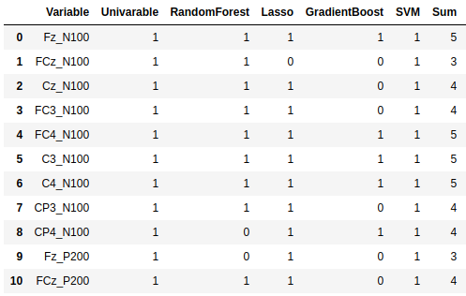
Feature selection
Describe the cutoff you decide for selecting the variables that will enter to your models.
Final number of total variables (and % of the initial number)

Slide 7
Dataset partition
Describe how do you decided to partition your data
Partition method
Partitions
Train (%)
Dev (%)
Test (%)
How did you verified the partition balance

Slide 8
Model Selection
Describe the results and which model was selected and why.
The example here is only for a classification problem. For a regression problem we use other metrics.
Substitute with the metrics you had used in your project
Model | Train |  | Dev
 | AUC | Accuracy | AUC | Accuracy
Logistic | 0.743 | 0.810 | 0.722 | 0.633
Decision Tree | 0.781 | 0.797 | 0.764 | 0.700
Random Forest | 0.783 | 0.822 | 0.756 | 0.789
AdaBoost | 0.799 | 0.812 | 0.781 | 0.774
Gradient Boosting | 0.824 | 0.841 | 0.797 | 0.749
SVM | 0.803 | 0.833 | 0.786 | 0.769

Slide 9
Model Fine-tuning
Describe the hyperparameters which were used to fine-tuning the model
Describe which technique was used to iterate through the hyperparameter values (Grid vs Random search)
What results were obtained - compare between the metrics on the train-set, dev-set and the test-set

Slide 10
Conclusion
Comment here some insights you get from the whole process of your data science project.

